Slide 1
Module 4: Understanding and Using APIs
Instructor Materials
DevNet Associate v1.0
Notes:
Cisco Networking Academy Program
DevNet Associate v1.0
Module 4: Understanding and Using APIs

Slide 2
Instructor Materials – Module 4 Planning Guide
This PowerPoint deck is divided in two parts:
Instructor Planning Guide
Information to help you become familiar with the module
Teaching aids
Instructor Class Presentation
Optional slides that you can use in the classroom
Begins on slide # 11
Note: Remove the Planning Guide from this presentation before sharing with anyone.
For additional help and resources go to the Instructor Home Page and Course Resources for this course. You also can visit the professional development site on www.netacad.com, the official Cisco Networking Academy Facebook page, or Instructor Only FB group.
Notes:
2

Slide 3
What to Expect in this Module
To facilitate learning, the following features may be included in this module:
Feature | Description
Hands-On Labs | Labs designed for working with physical equipment.
Module Quizzes | Self-assessments that integrate concepts and skills learned throughout the series of topics presented in the module.
Module Summary | Briefly recaps module content.

Slide 4
Check Your Understanding
Check Your Understanding activities are designed to let students quickly determine if they understand the content and can proceed, or if they need to review.
Check Your Understanding activities do not affect student grades.
There are no separate slides for these activities in the PPT. They are listed in the notes area of the slide that appears before these activities.
Notes:
4

Slide 5
Module 4: Activities
What activities are associated with this module?
Page # | Activity Type | Activity Name | Optional?
4.5.5 | Lab | Explore REST APIs with API simulator and postman | Recommended
4.9.2 | Lab | Integrating a REST API with Python | Recommended
Notes:
5

Slide 6
Module 4: Best Practices
Prior to teaching Module 4, the instructor should:
Review the activities and assessments for this module.
Try to include as many questions as possible to keep students engaged during classroom presentation.
Topic 4.1
Define Application Programming Interface (API).
Ask the class what is the purpose of using an API?
Notes:
6

Slide 7
Module 4: Best Practices (Contd.)
Topic 4.2
Discuss the difference between Asynchronous and Synchronous APIs. Ask the students to provide examples for Asynchronous and Synchronous APIs and have a discussion on the same.
Discuss the benefits of Asynchronous and Synchronous APIs.
Topic 4.3
Discuss API architectural styles: RPC, SOAP, and REST.
Provide examples of RPC, SOAP, and REST to the class. Ask them to brainstorm on the examples and identify the appropriate architectural style.
Notes:
7

Slide 8
Module 4: Best Practices (Contd.)
Topic 4.4
Explain the six principles of REST architectural style : Client-Server, Stateless, Cache, Uniform Interface, Layered System, Code-On-Demand.
Discuss the four major components of REST API requests : Uniform Resource Identifier , HTTP Method, Header, body.
Provide a URL and ask the students to categorize the scheme, authority, path, and query.
Ask the class if they are aware of the common HTTP errors. Discuss the common HTTP status codes.
Ask the students to research for the different examples of the status codes and share with the class by performing the errors on the computer.
Notes:
8

Slide 9
Module 4: Best Practices (Contd.)
Topic 4.5
Introduce Authentication and Authorization with different scenarios.
Discuss authentication mechanisms.
Explain the term ‘flow’ through authorization versions.
Topic 4.6
Provide an overview of ‘Rate limit’.
Explain the rate limit algorithm models with examples.
Discuss the causes of exceeding the rate limit.
Notes:
9

Slide 10
Module 4: Best Practices (Contd.)
Topic 4.7
Familiarize learners with Webhook.
Explain how Webhook is helping to receive notifications.
Topic 4.8
Differentiate between client-side error and server-side error along with its root causes and resolutions.
List 2xx,4xx and 5xx status codes along with its categories.
Provide sample status codes to the students and ask them to identify the errors and provide solutions.
Notes:
10

Slide 11
Module 4: Understanding and Using APIs
DevNet Associate v1.0
Notes:
Cisco Networking Academy Program
DevNet Associate v1.0
Module 4: Understanding and Using APIs
In-Session Activities / Explanations:
Time: 5 mins.
Instructor Notes:
Welcome the audience in a warm and cordial manner. Ensure that everyone is set up with the required resources.
Introduce the topic and encourage learners to come up with a list of expectations from the session. Collate topics on the white board or Desktop while using learner’s inputs to interpret them in words.
Read out the Objectives and briefly describe each.
Key Points: NA

Slide 12
Module Objectives
Module Title: Understanding and Using APIs
Module Objective: Create REST API requests over HTTPS to securely integrate services.
Topic Title | Topic Objective
Introducing APIs | Explain the use of APIs.
API Design Styles | Compare synchronous and asynchronous API design styles.
API Architecture Styles | Describe common API architecture styles.
Introduction to REST APIs | Explain the functions of REST APIs.
Authenticating a REST API | Create REST API requests over HTTPS to securely integrate services.
API Rate Limits | Explain the purpose of API rate limits
Working with Webhooks | Explain the use of webhooks.
Troubleshooting API calls | Explain how to troubleshoot REST APIs
Notes:
12
4 – Understanding and Using APIs
4.0.1 – Why should I take this module?

Slide 13
4.1 Introducing APIs
Notes:
Source:
4 - Understanding and Using APIs
4.1 - Introducing APIs
In-Session Activities / Explanations:
Time: 5 min
Instructor Notes:
Introduce API by providing examples of different types of API integrations.
Explain the uses of APIs by introducing the use cases supported by examples. (Refer to section 4.1.2)
After discussing the uses of APIs, ask the students what are their views on APIs being so popular or widely spread.
Key Points: API and API Use cases

Slide 14
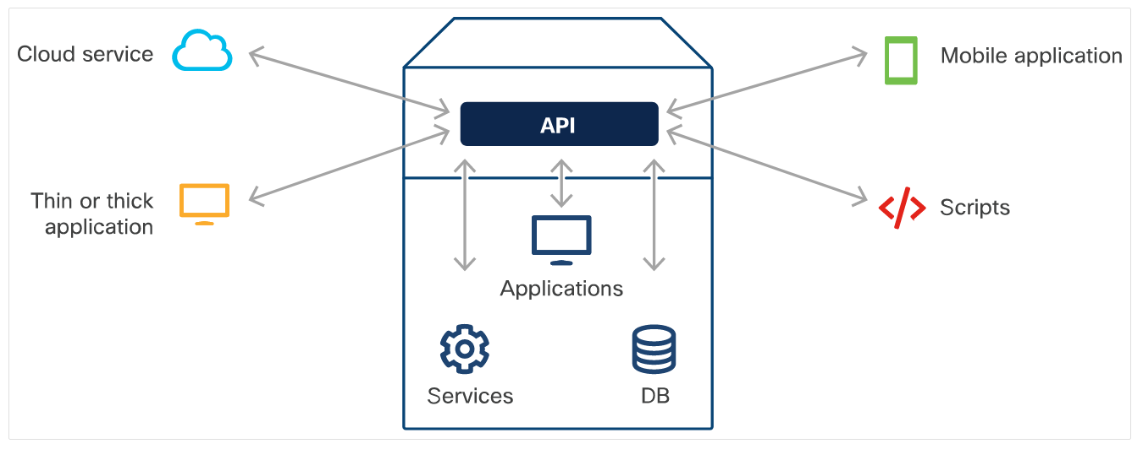
Understanding and Using APIs What is an API?
An Application Programming Interface (API) allows one piece of software talk to another.
It uses common web-based interactions or communication protocols and its own proprietary standards.
An API determines what type of data, services, and functionality the application exposes to third parties.
By providing APIs, applications can control what they expose in a secure way.
Example of different types of API integrations
Notes:
4 – Understanding and Using APIs
4.1 – Introducing APIs
4.1.1 – What is an API?

Slide 15
Understanding and Using APIs Why use APIs?
APIs are built to be consumed programmatically by other applications and they can also be used by humans who want to interact with the application manually.
Use cases of APIs are as follows:
Automation tasks – Build a script that performs manual tasks automatically and programmatically.
Data integration – An application can consume or react to data provided by another application.
Functionality – An application can integrate another application's functionality into its product.
Notes:
4 – Understanding and Using APIs
4.1 – Introducing APIs
4.1.2 – Why use APIs?

Slide 16
Understanding and Using APIs Why are APIs so popular?
APIs have existed for decades, but exposure and consumption of APIs has grown exponentially in the last 10 years or so.
Most modern APIs are designed into the product and are thoroughly tested.
Simplified coding languages such as Python have made it possible for non-software engineers to build applications and consume APIs.
Notes:
4 – Understanding and Using APIs
4.1 – Introducing APIs
4.1.3– Why are APIs so popular?

Slide 17
4.2 API Design Styles
Notes:
Source:
4 - Understanding and Using APIs
4.2 - API Design Styles
In-Session Activities / Explanations:
Time: 5 min
Instructor Notes:
Introduce API Design styles.
Discuss the differences between Asynchronous and Synchronous API with examples.
Key Points: Asynchronous API and Synchronous API

Slide 18
API Design Styles Types of Design Styles
A product’s set of APIs may consist of both synchronous and asynchronous designs, where each API’s design is independent of the others.
The application consuming the API manages the response differently depending on the API design.
Notes:
4 – Understanding and Using APIs
4.2 - API Design Styles
4.2.1 – Types of design styles

Slide 19
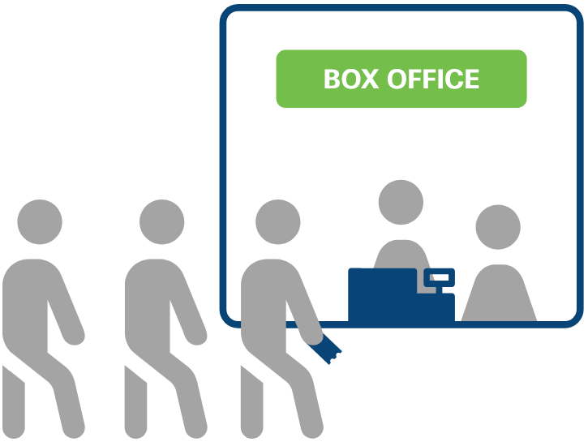
API Design Styles Synchronous APIs
Synchronous APIs respond to a request directly by providing data immediately.
When are APIs synchronous?
APIs are synchronous when the data for the request is readily available.
Benefits of a synchronous API design
Synchronous APIs enable the application to receive data immediately. If the API is designed correctly, the application performance will be better.
Client side processing
The application that is making the API request must wait for the response before performing any additional code execution tasks.
Synchronous APIs
Tickets are sold in first-come, first served order. This is a synchronous process.
Notes:
4 – Understanding and Using APIs
4.2 - API Design Styles
4.2.2 – Synchronous APIs

Slide 20
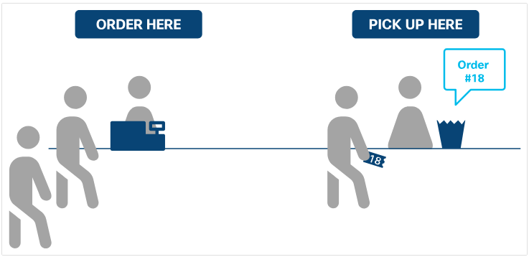
API Design Styles Asynchronous APIs
Asynchronous APIs provide a response (with no data) to signify that the request has been received.
When are APIs asynchronous?
APIs are asynchronous when the request takes some time for the server to process or if data isn’t readily available.
Benefit of asynchronous API design
Asynchronous APIs allow the application to continue execution without being blocked till the server processes the request, thus resulting in better performance.
Client-side processing
With asynchronous processing, the design of the API on the server side defines the requirement on the client side.
Asynchronous APIs
Notes:
4 – Understanding and Using APIs
4.2 - API Design Styles
4.2.3 – Asynchronous APIs

Slide 21
4.3 API Architectural Styles
Notes:
Source:
4 - Understanding and Using APIs
4.3 – API Architectural Styles
In-Session Activities / Explanations:
Time: 10 min
Instructor Notes:
Introduce API Architectural Styles and its types.
Explain each API Architectural Styles in detail.
Key Points: API Architectural Styles, RPC, SOAP, REST

Slide 22
API Architectural Styles Common Architectural Styles
There are certain standards, protocols, and specific architectural styles which make it easier for consumers of the API to learn and understand the API.
The three most popular types of API architectural styles are :
RPC
SOAP
REST
Notes:
4 – Understanding and Using APIs
4.3 - API Architectural Styles
4.3.1 – Common Architectural Styles

Slide 23
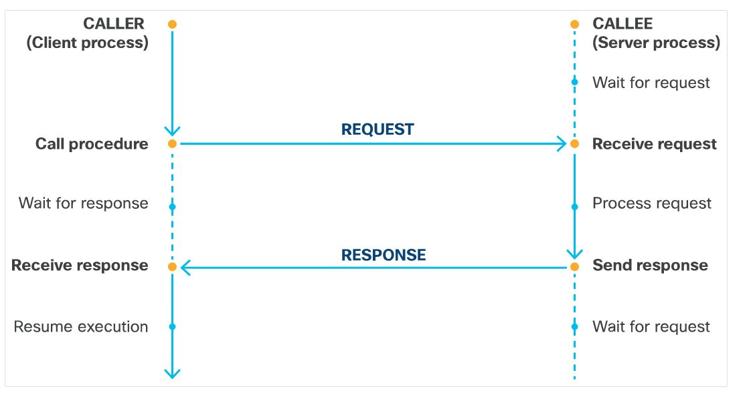
API Architectural Styles Remote Procedure Call (RPC)
Remote Procedure Call (RPC) is a request-response model that allows an application to make a procedure call to another application.
When RPC is called to a client, the method gets executed and the results get returned.
RPC is an API style that can be applied to different transport protocols such as:
XML-RPC
JSON-RPC
NFS (Network File System)
Simple Object Access Protocol (SOAP)
Remote Procedure Call client-server request/response model
Notes:
4 – Understanding and Using APIs
4.3 - API Architectural Styles
4.3.2 – Remote Procedure Call (RPC)

Slide 24
API Architectural Styles Simple Object Access Protocol (SOAP)
Simple Object Access Protocol (SOAP) is a XML- based messaging protocol. It is used for communication between applications on different platforms or built with different programming languages.
SOAP is:
Independent: All applications can communicate with each other and run on different operating systems
Extensible: Add features such as reliability and security
Neutral: Can be used over any protocol, including HTTP, SMTP, TCP, UDP, or JMS
A SOAP message is an XML document that may contain the following four elements:
Envelope – the root element of XML document.
Header - contains application-specific information such as authorization, SOAP-specific attributes and so on
Body - contains the data to be transported to the recipient
Fault - provides error and/or status information.
Notes:
4 – Understanding and Using APIs
4.3 - API Architectural Styles
4.3.3 – Simple Object Access Protocol (SOAP)

Slide 25
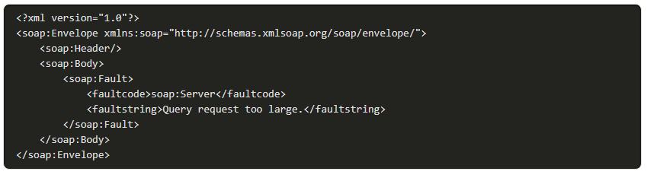
API Architectural Styles Simple Object Access Protocol (SOAP) (Contd.)
The following screenshot is an example of a SOAP message:
Notes:
4 – Understanding and Using APIs
4.3 - API Architectural Styles
4.3.3 – Simple Object Access Protocol (SOAP)

Slide 26
API Architectural Styles REpresentational State Transfer (REST)
REpresentational State Transfer (REST) is an architectural style authored by Roy Thomas Fielding.
Roy has established six constraints that can be applied to any protocol in REST.
Notes:
4 – Understanding and Using APIs
4.3 - API Architectural Styles
4.3.4 - Representational State Transfer (REST)

Slide 27
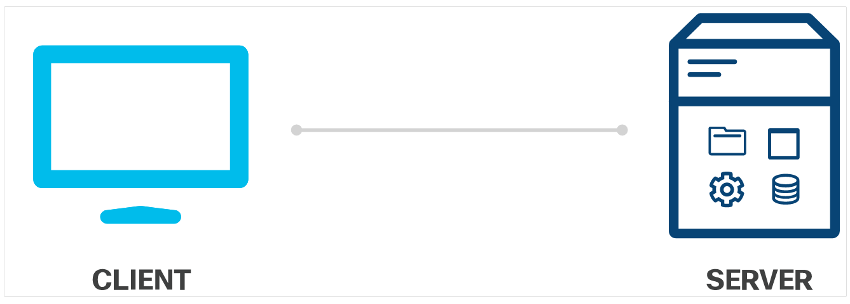
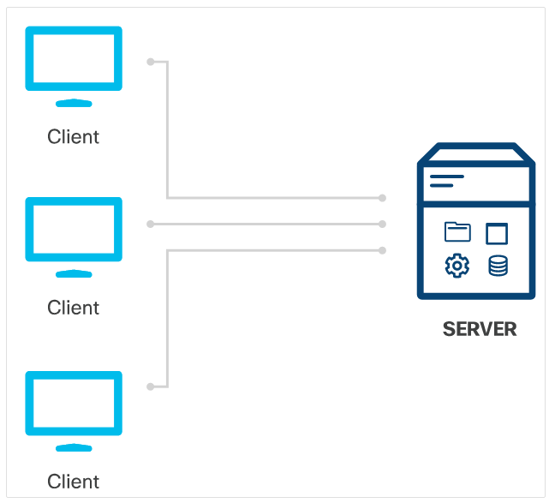
API Architectural Styles REpresentational State Transfer (REST) (Contd.)
Client-server
The client and server should be independent of each other.
This will enable the client to be built for multiple platforms which will simplify the server side components.
REST client-server model
Stateless
Requests from the client to the server must contain REST client-server model and all the information which the server needs to make the request.
The server cannot contain session states.
REST stateless model
Notes:
4 – Understanding and Using APIs
4.3 - API Architectural Styles
4.3.4 - Representational State Transfer (REST)

Slide 28
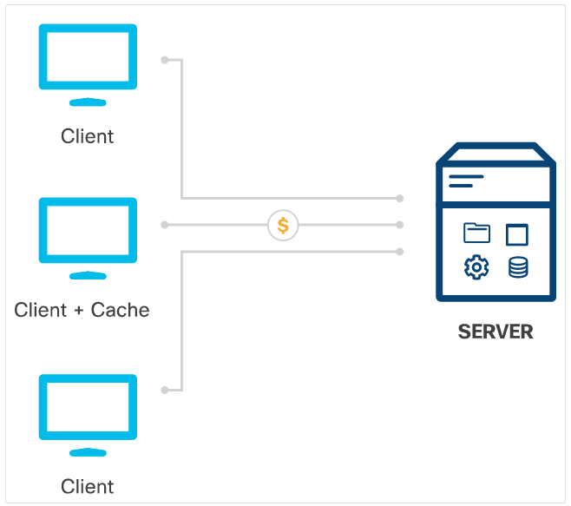
API Architectural Styles REpresentational State Transfer (REST) (Contd.)
Cache model:
Responses from the server must state whether the response is cacheable or non-cacheable.
If it is cacheable, the client can use the data from the response for later requests.
REST cache model
Uniform interface:
The interface between the client and the server adhere to the four principles:
Identification of resources
Manipulation of resources through representations
Self-descriptive messages
Hypermedia as the engine of application state.
Notes:
4 – Understanding and Using APIs
4.3 - API Architectural Styles
4.3.4 - REpresentational State Transfer (REST)

Slide 29
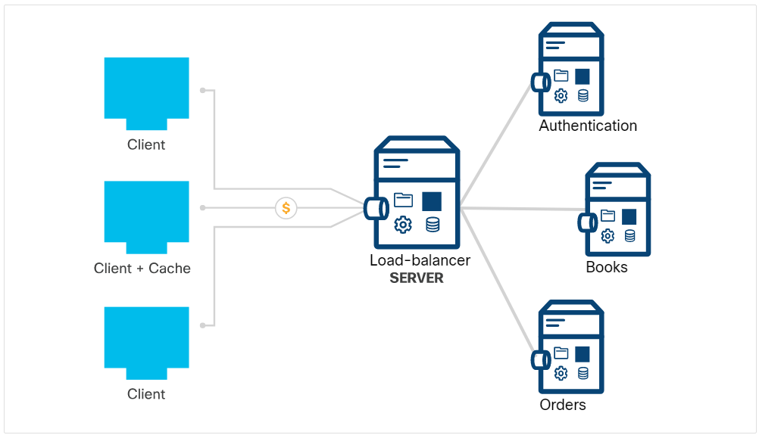
API Architectural Styles REpresentational State Transfer (REST) (Contd.)
Layered system:
The Layered system consists of different hierarchical layers in which each layer provides services only to the layer above it.
As a result, it consumes services from the layer below.
REST layered system model
Code-on-demand:
The information returned by a REST service can include executable code (for example, javascript) or links intended to usefully extend client functionality.
The constraint is optional because execution of third-party codes introduces potential security risks.
Notes:
4 – Understanding and Using APIs
4.3 - API Architectural Styles
4.3.4 - REpresentational State Transfer (REST)

Slide 30
4.4 Introduction to REST APIs
Notes:
Source:
4 - Understanding and Using APIs
4.4 - Introduction to REST APIs
In-Session Activities / Explanations:
Time: 17 min
Instructor Notes:
Introduce the topic Rest APIs
Explain the components of REST API.
Explain the components of URI.
Explain API request and responses.
Key Points: REST APIs requests, REST APIs responses.

Slide 31
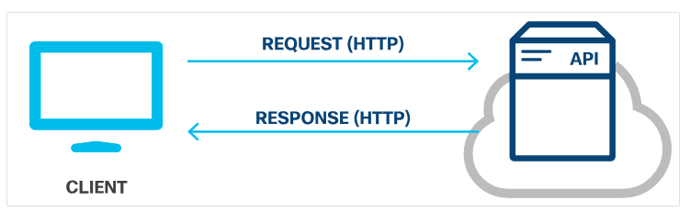
Introduction to REST APIs REST Web Service APIs
A REST Web service API (REST API) is a programming interface that communicates over HTTP.
REST APIs use the same concepts as the HTTP protocol which are as follows:
HTTP requests/responses
HTTP verbs
HTTP status codes
HTTP headers/body
REST API request/response model
Notes:
4 – Understanding and Using APIs
4.4-Introduction to REST APIs
4.4.1-REST Web Service APIs

Slide 32
Introduction to REST APIs REST API Requests
REST API requests are HTTP requests that are a way for an application (client) to ask the server to perform a function.
REST API requests are made up of four major components:
Uniform Resource Identifier (URI)
HTTP Method
Header
Body
Notes:
4 – Understanding and Using APIs
4.4-Introduction to REST APIs
4.4.2-REST API Requests

Slide 33
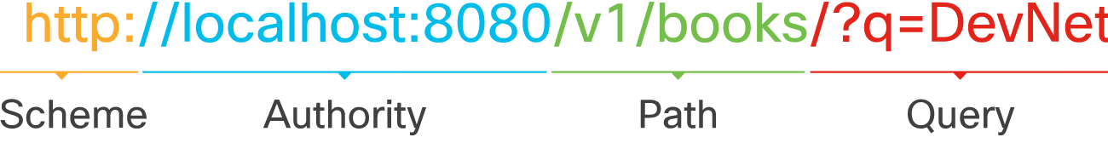
Introduction to REST APIs REST API Requests (Contd.)
The Uniform Resource Identifier (URI), also referred to as Uniform Resource Locator (URL), identifies which resource the client wants to manipulate. The components of a URI are:
Scheme: specifies which HTTP protocol should be used, http or https.
Authority: consists of two parts, namely, host and port.
Path: represents the location of the resource, the data or object, to be manipulated on the server.
Query: provides additional details for scope, filtering, or to clarify a request.
Different components of a URI
Notes:
4 – Understanding and Using APIs
4.4-Introduction to REST APIs
4.4.2-REST API Requests

Slide 34
Introduction to REST APIs REST API Requests (Contd.)
HTTP method:
REST APIs use the standard HTTP methods to communicate to the web services for which action is being requested for the given resource.
The suggested mapping of the HTTP Method to the action is as follows:
HTTP Method | Action | Description
POST | Create | Create a new object or resource.
GET | Read | Retrieve resource details from the system.
PUT | Update | Replace or update an existing resource.
PATCH | Partial Update | Update some details from an existing resource.
DELETE | Delete | Remove a resource from the system.
Notes:
4 – Understanding and Using APIs
4.4-Introduction to REST APIs
4.4.2-REST API Requests

Slide 35
Introduction to REST APIs REST API Requests (Contd.)
Header:
HTTP headers are formatted as name-value pairs that are separated by a colon ( : ), [name]:[value].
Two types of headers:
Request headers - Include additional information that does not relate to the content of the message.
Key | Example Value | Description
Authorization | Basic dmFncmFudDp2YWdyYW | Provide credentials to authorize the request
Entity headers - Additional information that describes the content of the body of the message.
Key | Example Value | Description
Content-Type | application/ json | Specify the format of the data in the body
Notes:
4 – Understanding and Using APIs
4.4-Introduction to REST APIs
4.4.2-REST API Requests

Slide 36
Introduction to REST APIs REST API Requests (Contd.)
Body:
The body of the REST API request contains the data pertaining to the resource that the client wants to manipulate.
REST API requests that use the HTTP method POST, PUT, and PATCH typically include a body.
The body is optional depending on the HTTP method.
If the data is provided in the body, then the data type must be specified in the header using the Content-Type key.
Notes:
4 – Understanding and Using APIs
4.4-Introduction to REST APIs
4.4.2-REST API Requests

Slide 37
Introduction to REST APIs REST API Responses
REST API responses are HTTP responses that communicate the results of a client's HTTP request.
REST API Responses are made up of three major components:
HTTP Status
Header
Body
Notes:
4 – Understanding and Using APIs
4.4-Introduction to REST APIs
4.4.3 – REST API Responses

Slide 38
Introduction to REST APIs REST API Responses (Contd.)
HTTP Status
The HTTP status code help the client determine the reason for the error and can sometimes provide suggestions for fixing the problem.
HTTP status codes consists of three digits, where the first digit is the response category and the other two digits are assigned in numerical order.
There are five different categories of HTTP status codes:
1xx – Informational – for informational purposes, responses do not contain a body
2xx – Success – the server received and accepted the request
3xx – Redirection – the client has an additional action to take to get the request completed
4xx -- Client Error – the request contains an error such as bad syntax or invalid input
5xx -- Server Error – unable to fulfill the valid requests.
Notes:
4 – Understanding and Using APIs
4.4-Introduction to REST APIs
4.4.3 – REST API Responses

Slide 39
Introduction to REST APIs REST API Responses (Contd.)
The common HTTP status codes are as follows:
HTTP Status Code | Status Message | Description
200 | Ok | Request was successfully and typically contains a payload (body)
201 | Created | Request was fulfilled and the requested resource was created
202 | Accepted | Request has been accepted for processing and is in process
400 | Bad Request | Request will not be processed due to an error with the request
401 | Unauthorized | Request does not have valid authentication credentials to perform the request
403 | Forbidden | Request was understood but has been rejected by the server
404 | Not Found | Request cannot be fulfilled because the resource path of the request was not found on the server
500 | Internal Server Error | Request cannot be fulfilled due to a server error
503 | Service Unavailable | Request cannot be fulfilled because currently the server cannot handle the request
Notes:
4 – Understanding and Using APIs
4.4-Introduction to REST APIs
4.4.3 – REST API Responses

Slide 40
Introduction to REST APIs REST API Responses (Contd.)
Header - The header in the response is to provide additional information between the server and the client in the name-value pair format that is separated by a colon ( : ), [name]:[value].There are two types of headers: response headers and entity headers.
Response headers – It contains additional information that doesn't relate to the content of the message. The typical response headers for a REST API request include:
Key | Example Value | Description
Set-Cookie | JSESSIONID=30A9DN810FQ428P; Path=/ | Used to send cookies from the server
Cache-Control | Cache-Control: max-age=3600, public | Specify directives which MUST be obeyed by all caching mechanisms
Entity headers – They are additional information that describes the content of the body of the message. One common entity header specifies the type of data being returned:
Key | Example Value | Description
Content-Type | application/json | Specify the format of the data in the body
Notes:
4 – Understanding and Using APIs
4.4-Introduction to REST APIs
4.4.3 – REST API Responses

Slide 41
Introduction to REST APIs REST API Responses (Contd.)
Response Pagination
Response Pagination enables data to be broken into chunks.
Most APIs that implement pagination use the query parameter to specify which page to return in the response.
Compressed response data
Compressed data reduces large amount of data that cannot be paginated
To request a data compression, the request must add the Accept-Encoding field to the request header. The accepted values are:
gzip
compress
deflate
br
identity
*
Notes:
4 – Understanding and Using APIs
4.4-Introduction to REST APIs
4.4.3 – REST API Responses

Slide 42
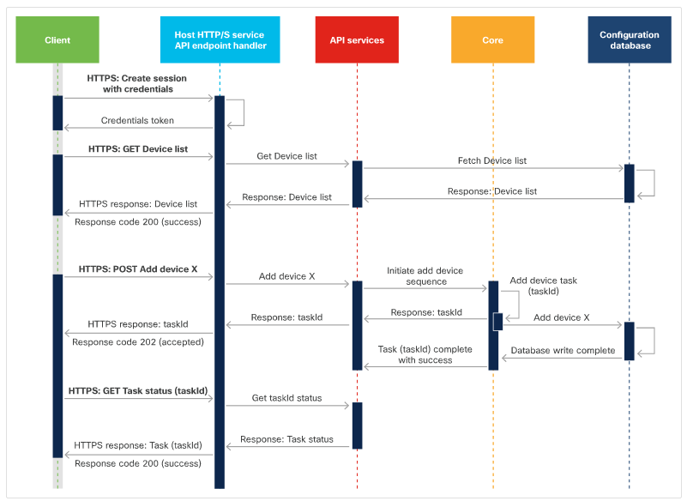
Introduction to REST APIs Using Sequence Diagrams with REST API
Sequence diagrams are used to explain a sequence of exchanges or events.
API request sequence diagram has three separate sequences:
Create session- the starting request is labeled as HTTPS: Create Session w/credentials.
Get devices - request a list of devices from the platform.
Create device – begins with a POST request to create a device.
API Request/Response Sequence Diagram
Notes:
4 – Understanding and Using APIs
4.4-Introduction to REST APIs
4.4. 4 - Using Sequence Diagrams with REST API

Slide 43
4.5 Authenticating to a REST API
Notes:
Source:
4 - Understanding and Using APIs
4.5 - Authenticating to a REST API
In-Session Activities / Explanations:
Time: 20 min
Instructor Notes:
Provide an overview of REST API authentication.
Explain Authentication and authorization with examples.
Explain Authentication and authorization mechanisms.
At the end of the topic, enquire how the learners performed during the REST APIs with API Simulator and Postman Lab.
Key Points: Authentication and Authorization.

Slide 44
Authenticating to a REST API REST API Authentication
REST APIs require authentication so that random users cannot access, create, update, or delete information incorrectly or maliciously.
Some APIs that do not require authentication are read-only and they do not contain any critical or confidential information.
Notes:
4 – Understanding and Using APIs
4.5 - Authenticating to a REST APIs
4.5.1 – REST API authentication

Slide 45


Authenticating to a REST API Authentication Vs. Authorization
Authentication:
Authentication proves the user’s identity.
For example, when you go to the airport, you have to show your government-issued identification or use biometrics to prove that you are the person you claim to be.
Authorization:
Authorization defines the user access.
It is the act where the user is proving to have permissions to perform the requested action on that resource.
For example, when you go to a concert, all you need to show is your ticket to prove that you are allowed in.
Notes:
4 – Understanding and Using APIs
4.5 - Authenticating to a REST APIs
4.5.2– Authentication Vs. Authorization

Slide 46
Authenticating to a REST API Authentication mechanisms
The common types of authentication mechanisms include:
Basic authentication: It transmits credentials as username/password pairs separated with a colon (:) and encoded using Base64.
Bearer authentication: It uses a bearer token, which is a string generated by an authentication server such as an Identity Service (IdS).
API Key: It is a unique alphanumeric string generated by the server and assigned to a user. The two types of API keys are public and private.
Notes:
4 – Understanding and Using APIs
4.5-Authenticating to a REST APIs
4.5.3– Authentication Mechanisms

Slide 47
Authenticating to a REST API Authorization Mechanisms
Open Authorization (Oauth) combines authentication with authorization.
Oauth was developed as a solution to insecure authentication mechanisms.
Oauth has increased security as compared to other options.
There are two versions of Oauth - OAuth 1.0 and OAuth 2.0, where OAuth 2.0 is not backwards compatible.
OAuth 2.0 authorization framework enables a third-party application to obtain limited access to an HTTP service.
OAuth allows the user to provide credentials directly to the authorization server [Identity Provider (IdP) or an Identity Service (IdS)], to obtain an access token to share with the application.
The process of obtaining the token is called a flow.
Notes:
4 – Understanding and Using APIs
4.5-Authenticating to a REST APIs
4.5.4– Authorization Mechanisms

Slide 48
Authenticating to a REST API Lab - Explore REST APIs with API Simulator and Postman
In this lab, you will complete the following objectives:
Part 1: Launch the DEVASC VM
Part 2: Explore API Documentation Using the API Simulator
Part 3: Use Postman to Make API Calls to the API Simulator
Part 4: Use Python to Add 100 Books to the API Simulator
Notes:
4 – Understanding and Using APIs
4.5 – Authenticating to a REST APIs
4.5.5 – Lab - Explore REST APIs with API Simulator and Postman

Slide 49
4.6 API Rate Limits
Notes:
Source:
4 - Understanding and Using APIs
4.6 - API Rate Limits
In-Session Activities / Explanations:
Time: 7 min
Instructor Notes:
Introduce the topic and discuss rate limits
Explain rate limit algorithm along with its example.
Explain what will happen if one exceeds API rate limits.
Key Points: Rate limits, rate limit algorithm, knowing the rate limit, exceeding the rate limits.

Slide 50
API Rate Limits What are Rate Limits?
An API rate limit is a way for a web service to control the number of requests a user or an application can make per defined unit of time.
Rate limiting helps to :
avoid a server overload from too many requests at once
provide better service and response time to all users
protect against a Denial-of-Service (DoS) attack
Notes:
4 – Understanding and Using APIs
4.6 – API Rate Limits
4.6.1 – What are Rate Limits?

Slide 51
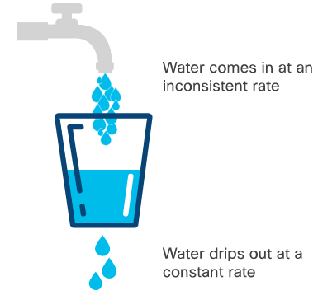
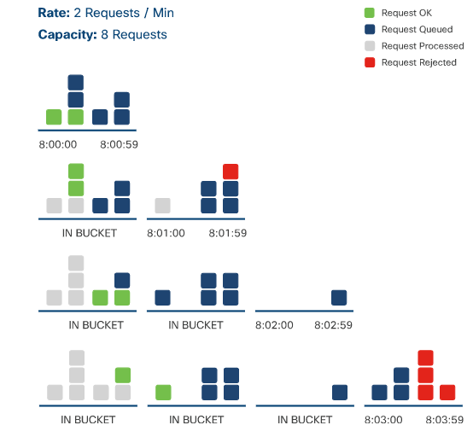
API Rate Limits Rate Limit Algorithms
Leaky bucket
This algorithm puts all incoming requests into a request queue in the order in which they were received.
The incoming requests can come in at any rate, but the server will process the requests from the queue at a fixed rate.
If the request queue is full, the request is rejected
Visual representation of leaky bucket algorithm
Example of leaky bucket algorithm
Notes:
4 – Understanding and Using APIs
4.6 – API Rate Limits
4.6.2- Rate limit algorithms

Slide 52
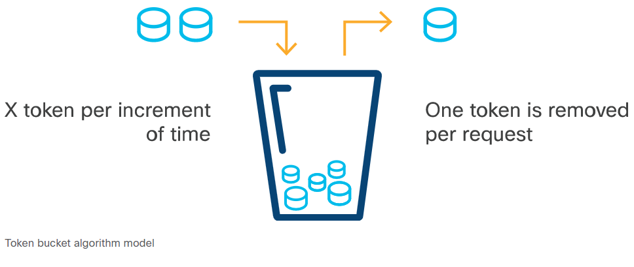
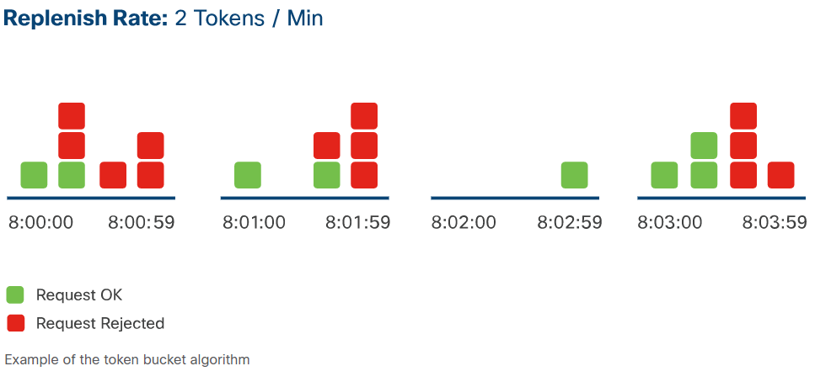
API Rate Limits Rate Limit Algorithms (Contd.)
Token bucket
This algorithm gives each user a defined number of tokens they can use within a certain increment of time.
When the client makes a request, the server checks the bucket to make sure it contains at least one token. If so, it removes that token and processes the request. If there isn't a token available, it rejects the request.
The client must calculate the number of tokens he currently has to avoid rejected requests.
Token Bucket Algorithm model
Example of the token bucket algorithm
Notes:
4 – Understanding and Using APIs
4.6 – API Rate Limits
4.6.2- Rate limit algorithms

Slide 53
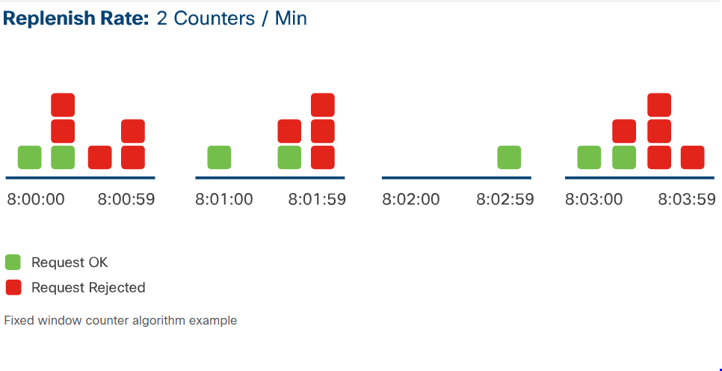
API Rate Limits Rate Limit Algorithms (Contd.)
Fixed window counter
In fixed window counter algorithm, a fixed window of time is assigned a counter to represent how many requests can be processed during that period.
When the server receives a request, the counter for the current window of time must be zero.
When the request is processed, the counter is deducted. If the limit for that window of time is met, all subsequent requests within that window of time will be rejected.
Fixed Window Counter Algorithm Example
Notes:
4 – Understanding and Using APIs
4.6 – API Rate Limits
4.6.2- Rate limit algorithms

Slide 54
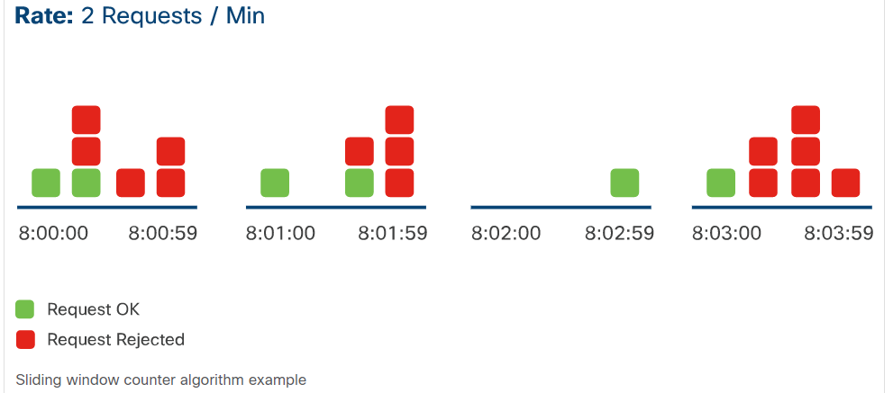
API Rate Limits Rate Limit Algorithms (Contd.)
Sliding window counter
This algorithm allows a fixed number of requests to be made in a set duration of time.
When a new request is made, the server counts how many requests have already been made from the beginning of the window to the current time to determine if the request should be processed or rejected.
The client needs to ensure that the rate limit does not exceed at the time of the request.
Sliding Window Counter Algorithm Example
Notes:
4 – Understanding and Using APIs
4.6 – API Rate Limits
4.6.2- Rate limit algorithms

Slide 55
API Rate Limits Knowing the Rate Limit
Many rate limiting APIs add details about the rate limit in the response's header.
The commonly used Rate Limit keys include:
X-Rate Limit-Limit - The maximum number of requests that can be made in a specified unit of time.
X-Rate Limit-Remaining - The number of pending requests that the requester can make in the current rate limit window
X-Rate Limit-Reset - The time when the rate limit window will reset.
Notes:
4 – Understanding and Using APIs
4.6 – API Rate Limits
4.6.3- Knowing the Rate Limit

Slide 56
API Rate Limits Exceeding the Rate Limit
When the rate limit is exceeded, the server automatically rejects the request and sends back an HTTP response to the user.
The response containing the ‘rate limit exceeded’ error also includes a meaningful HTTP status code.
The most commonly used HTTP status codes are 429: Too Many Requests or 403: Forbidden.
Notes:
4 – Understanding and Using APIs
4.6 – API Rate Limits
4.6.4- Exceeding the Rate Limit

Slide 57
4.7 Working with Webhooks
Notes:
Source:
4 - Understanding and Using APIs
4.7 - Working with Webhooks
In-Session Activities / Explanations:
Time: 5 min
Instructor Notes:
Walk the learners through webhooks with examples.
Explain the process of consuming a webhook.
Key Points: Webhook, Consuming Webhook.

Slide 58
Working with Webhooks What is a Webhook?
A Webhook is an HTTP callback, or an HTTP POST, to a specified URL that notifies the application when a particular activity or event is occurred in the resources.
With webhooks, applications are more efficient as polling mechanisms are not required.
Webhooks are also known as reverse APIs, because applications subscribe to a webhook server by registering with the webhook provider.
Multiple applications can subscribe to a single webhook server.
Examples:
The Cisco DNA Center platform provides webhooks that enable third-party applications to receive network data when specified events occur.
You can create a webhook to have Cisco Webex Teams notify you of new messages posted in a particular room.
Notes:
4 – Understanding and Using APIs
4.7 –Working with Webhooks
4.7.1- What is a Webhook?

Slide 59
Working with Webhooks Consuming a Webhook
In order to receive a notification from a webhook provider, the application must meet certain requirements:
The application must be running at all times to receive HTTP POST requests.
The application must register a URI on the webhook provider.
Also, the application must handle the incoming notifications from the webhook server.
Use free online tools to ensure the application is receiving notifications from a webhook.
Notes:
4 – Understanding and Using APIs
4.7 –Working with Webhooks
4.7.1- Consuming a Webhook

Slide 60
4.8 Troubleshooting API Calls
Notes:
Source:
4 - Understanding and Using APIs
4.8 - Troubleshooting API Calls
In-Session Activities / Explanations:
Time: 15 mins
Instructor Notes:
Discuss the different Troubleshooting issues.
Discuss the HTTP status codes examples.
Interpret status codes.
Key Points: Troubleshooting, Client-side error, server-side error, status codes. 2xx, 4xx, 5xx status codes.

Slide 61
Troubleshooting API Calls Troubleshooting REST API Requests
There will be instances where you will make an API request but will not get the expected response. Hence, learning to troubleshoot the most common REST API issues is important.
Always have the API reference guide and API authentication information handy while troubleshooting the REST API issues.
Notes:
4 – Understanding and Using APIs
4.8 - Troubleshooting API Calls
4.8.1 - Troubleshooting REST API Requests

Slide 62

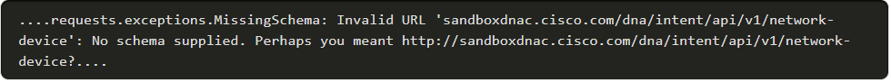
Troubleshooting API Calls No Response and HTTP Status Code from the API server
Sometimes API servers cannot be reached or fail to respond. You can identify what went wrong from the error messages received as a result of the request.
Troubleshooting tips for client side error:
User error: Mistyping the URI when using the API for the first time.
Invalid URI Example – To test the invalid URI condition, run a script which makes the request to a URI that is missing the scheme.
The traceback will be as follows:
Notes:
4 – Understanding and Using APIs
4.8 - Troubleshooting API Calls
4.8.2 - No Response and HTTP Status Code from the API server

Slide 63
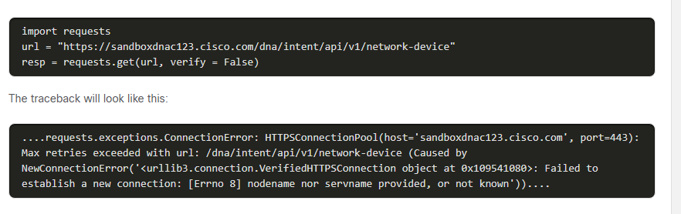
Troubleshooting API Calls No Response and HTTP Status Code from the API server (Contd.)
Wrong Domain name Example – To test the wrong domain name condition, run a script which simply makes the request to a URI that has the wrong domain name.
Notes:
4 – Understanding and Using APIs
4.8 - Troubleshooting API Calls
4.8.2 - No Response and HTTP Status Code from the API server

Slide 64
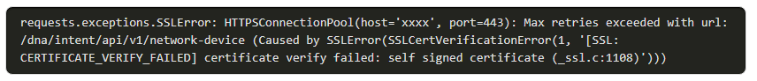
Troubleshooting API Calls No Response and HTTP Status Code from the API server (Contd.)
Connectivity Issues
Are there any Proxy, Firewall or VPN issues?
Is there an SSL error?
Invalid Certificate Example
This issue can only occur if the REST API URI uses a secure connection (HTTPS).
When the scheme of the URI is HTTPS, the connection will perform an the SSL handshake between the client and the server. If it fails, fix the invalid certificate
Traceback:
Notes:
4 – Understanding and Using APIs
4.8 - Troubleshooting API Calls
4.8.2 - No Response and HTTP Status Code from the API server

Slide 65
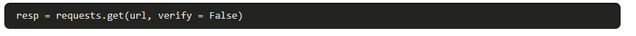
Troubleshooting API Calls No Response and HTTP Status Code from the API server (Contd.)
But, if you are working in a lab environment where the certificates aren't valid yet, you can turn off the certificate verification setting.
To turn it off for the requests library in Python, add the verify parameter to the request.
Resolution:
Fix the issue by identifying the root cause.
Notes:
4 – Understanding and Using APIs
4.8 - Troubleshooting API Calls
4.8.2 - No Response and HTTP Status Code from the API server

Slide 66
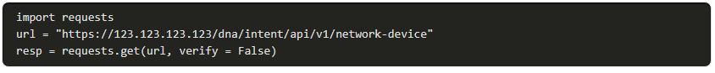
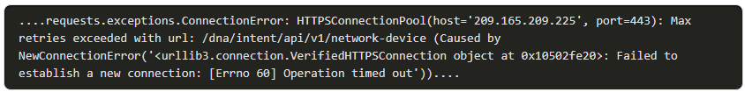
Troubleshooting API Calls No Response and HTTP Status Code from the API server (Contd.)
Troubleshooting tips for server side error :
API server functioning – poweroff, cabling issues, domain name change, network down.
To test if the IP address is accessible, run a script which makes the request to the URL and waits for a response.
If the API server is not functioning, you will get a long silence followed by a traceback that will be as follows:
Notes:
4 – Understanding and Using APIs
4.8 - Troubleshooting API Calls
4.8.2 - No Response and HTTP Status Code from the API server

Slide 67
Troubleshooting API Calls No Response and HTTP Status Code from the API server (Contd.)
Is there a communication issue between the API server and the client?
Use a network capturing tool to see if the response from the API server is lost in the communication between the API server and the client..
If you have access, take a look at the API server logs if the request was received.
Resolution:
Server side issues cannot be resolved from the API client side.
Contact the administrator of the API server to resolve this issue.
Notes:
4 – Understanding and Using APIs
4.8 - Troubleshooting API Calls
4.8.2 - No Response and HTTP Status Code from the API server

Slide 68
Troubleshooting API Calls Interpreting Status Codes
The status code is a part of HTTP/1.1 standard (RFC 7231), where the first digit defines the class of the response and the last two digits do not have any class or categorization role.
The five categories of status codes are as follows:
1xx: Informational - Request received, continuing to process.
2xx: Success - The action was successfully received, understood, and accepted.
3xx: Redirection - Further action must be taken in order to complete the request.
4xx: Client Error - The request contains bad syntax or cannot be fulfilled.
5xx: Server Error - The server failed to fulfill an apparently valid request.
Steps to troubleshoot errors:
Check the return code - It can help to output the return code in the script during the development phase.
Check the response body - Output the response body during development
Use status code reference – If the issues cannot be resolved by checking the return code and response body.
Notes:
4 – Understanding and Using APIs
4.8 - Troubleshooting API Calls
4.8.3 - Interpreting Status Codes

Slide 69
Troubleshooting API Calls 2xx and 4xx Status Codes
2xx – Success error: Successfully received, understood and accepted
4xx – Client side error: Error is on the client side.
Troubleshooting common 4xx errors:
400 – Bad request
The request could not be understood by the server due to malformed syntax, which is mainly due to:
Misspelling of resources
Syntax issue in JSON object.
Notes:
4 – Understanding and Using APIs
4.8 - Troubleshooting API Calls
4.8.4 - 2xx and 4xx Status Codes

Slide 70
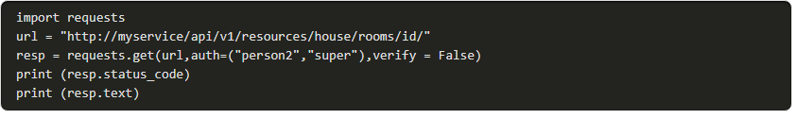
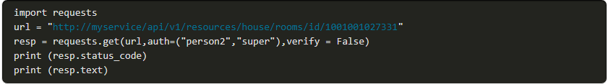
Troubleshooting API Calls 2xx and 4xx Status Codes (Contd.)
Example : This example returns a status code of 400.
The server side also tells you "No id field provided", because the id is mandatory for this API request.
Notes:
4 – Understanding and Using APIs
4.8 - Troubleshooting API Calls
4.8.4 - 2xx and 4xx Status Codes

Slide 71
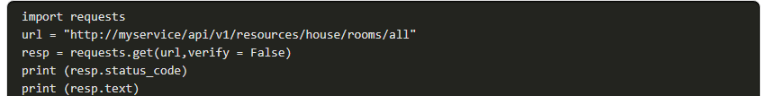
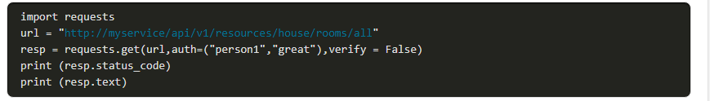
Troubleshooting API Calls 2xx and 4xx Status Codes (Contd.)
401 – Unauthorized:
This error message means the server could not authenticate the request.
Check your credentials, including username, password, API key, token, request URI
Example
The authentication auth=("person1","great") should be added in the code
Notes:
4 – Understanding and Using APIs
4.8 - Troubleshooting API Calls
4.8.4 - 2xx and 4xx Status Codes

Slide 72
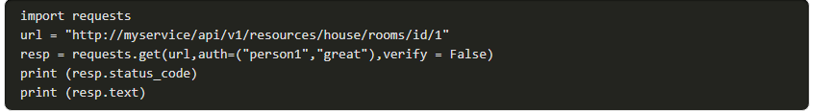
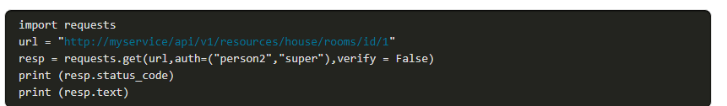
Troubleshooting API Calls 2xx and 4xx Status Codes (Contd.)
403 – Forbidden
The server recognizes the authentication credentials, but the client is not authorized to perform the request.
Example: The status code 403 is not an authentication issue; it is just that the user does not have enough privileges to use that particular API.
The authentication should be modified to use person2/super instead of person1/great.
Notes:
4 – Understanding and Using APIs
4.8 - Troubleshooting API Calls
4.8.4 - 2xx and 4xx Status Codes

Slide 73
Troubleshooting API Calls 2xx and 4xx Status Codes (Contd.)
407 - Proxy Authentication Required
This code is similar to 401 (Unauthorized), but it indicates that the client must first authenticate itself with the proxy.
In this scenario, there is a proxy server between the client and the server, and the 407 response code indicates that the client needs to authenticate with the proxy server first.
409 - The request could not be completed due to a conflict with the current state of the target resource.
For example, an edit conflict where a resource is being edited by multiple users would cause a 409 error.
Retrying the request later might succeed, as long as the conflict is resolved by the server.
Notes:
4 – Understanding and Using APIs
4.8 - Troubleshooting API Calls
4.8.4 - 2xx and 4xx Status Codes

Slide 74
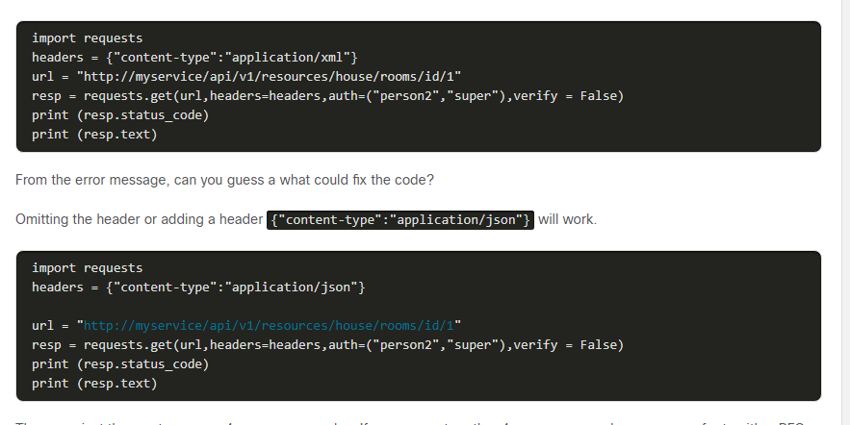
Troubleshooting API Calls 2xx and 4xx Status Codes (Contd.)
415 - Unsupported Media Type
In this case, the client sent a request body in a format that the server does not support.
Example: If the client sends XML to a server that only accepts JSON, the server would return a 415 error.
Omitting the header or adding a header {"content-type":"application/ json"} will work.
Notes:
4 – Understanding and Using APIs
4.8 - Troubleshooting API Calls
4.8.4 - 2xx and 4xx Status Codes

Slide 75
Troubleshooting API Calls 5xx Status Codes
500 - Internal Server Error
The server encountered an unexpected condition that prevented it from fulfilling the request.
501 - Not Implemented
The server does not support the functionality required to fulfill this request
502 - Bad Gateway
The server (acting as gateway or proxy) received an invalid response from an inbound server.
503 - Service Unavailable
The server is currently unable to handle the request due to overload or scheduled maintenance.
504 - Gateway Timeout
The server (acting as a gateway or proxy) did not receive timely response from an upstream server.
Notes:
4 – Understanding and Using APIs
4.8 - Troubleshooting API Calls
4.8.5- 5xx Status Codes

Slide 76
4.9 Understanding and Using APIs Summary
Notes:
Source:
4 - Understanding and Using APIs
4.9 - Understanding and Using APIs Summary In-Session Activities / Explanations:
Time: 20 mins
Instructor Notes:
Read out the summary points mentioned on the slide.
Discuss the same with the participants.
Ask if they have any questions or doubts.
At the end of the topic, enquire how the learners performed during Integrating a REST API with Python.
Ensure that the learners complete the quiz in 4.9.3.
Key Points: NA

Slide 77
Troubleshooting API Calls What Did I Learn in this Module?
API defines the ways users, developers, and other applications can interact with an application's components.
An API can use common web-based interactions or communication protocols and its own proprietary standards.
APIs can be delivered synchronously (or) asynchronously.
The three most popular types of API architectural styles are RPC, SOAP, and REST.
A REST web service API (REST API) is a programming interface that communicates over HTTP while adhering to the principles of the REST architectural style.
Authentication is the act of verifying the user's identity. Common types of authentication mechanisms include Basic, Bearer, and API Key.
Authorization is the act where the user is proving to have permissions to perform the requested action on that resource.
Notes:
4 – Understanding and Using APIs
4.9 - Understanding and Using APIs Summary
4.9.1 – What did I learn in this module?

Slide 78
Troubleshooting API Calls What Did I Learn in this Module? (Contd.)
An API Rate limit is a way for a web service to control the number of requests a user or an application can make per defined unit of time.
A webhook is an HTTP callback, or an HTTP POST, to a specified URL that notifies your application in case of an activity or ‘event’ in one of your resources on the platform.
The API reference guide and API authentication information must be handy before troubleshooting.
Client side errors include user error, wrong URI, wrong domain, a connectivity issue, and an invalid certificate.
Server side error includes communication problems between the server and the client.
4xx codes are Client side errors and 5xx codes are Server side errors.
Notes:
4 – Understanding and Using APIs
4.9 - Understanding and Using APIs Summary
4.9.1 – What did I learn in this module?

Slide 79
Troubleshooting API Calls Lab – Integrating a REST API with Python
In this lab, you will complete the following objectives:
Part 1: Launch the DEVASC VM
Part 2: Demonstrate the MapQuest Directions Application
Part 3: Get a MapQuest API Key
Part 4: Build the Basic MapQuest Direction Application
Part 5: Upgrade the MapQuest Directions Application with More Features
Part 6: Test Full Application Functionality
Notes:
4 – Understanding and Using APIs
4.9 - Understanding and Using APIs Summary
4.9.2 - Lab – Integrating a REST API with Python
4.9.3 – Module 4: Understanding and Using APIs Quiz

Slide 80
Module 4 New Terms and Commands
Application Programming Interface (API) Remote Procedure Call (RPC) Simple Object Access Protocol (SOAP) REpresentational State Transfer (REST) | Uniform Resource Identifier (URI) Unified Modeling Language (UML) Identity Service (IdS) Open Authorization (Oauth) Denial-of-Service (DoS)
Notes:
4 – Understanding and Using APIs
New Terms and Commands

